Slide 1





Revealing Political Donors’ Motivations:
The Connection Between Donations and Social Media
Ross Dahlke
@ross_dahlke
github.com/rossdahlke
Stanford University
rdahlke@stanford.edu

Slide 2
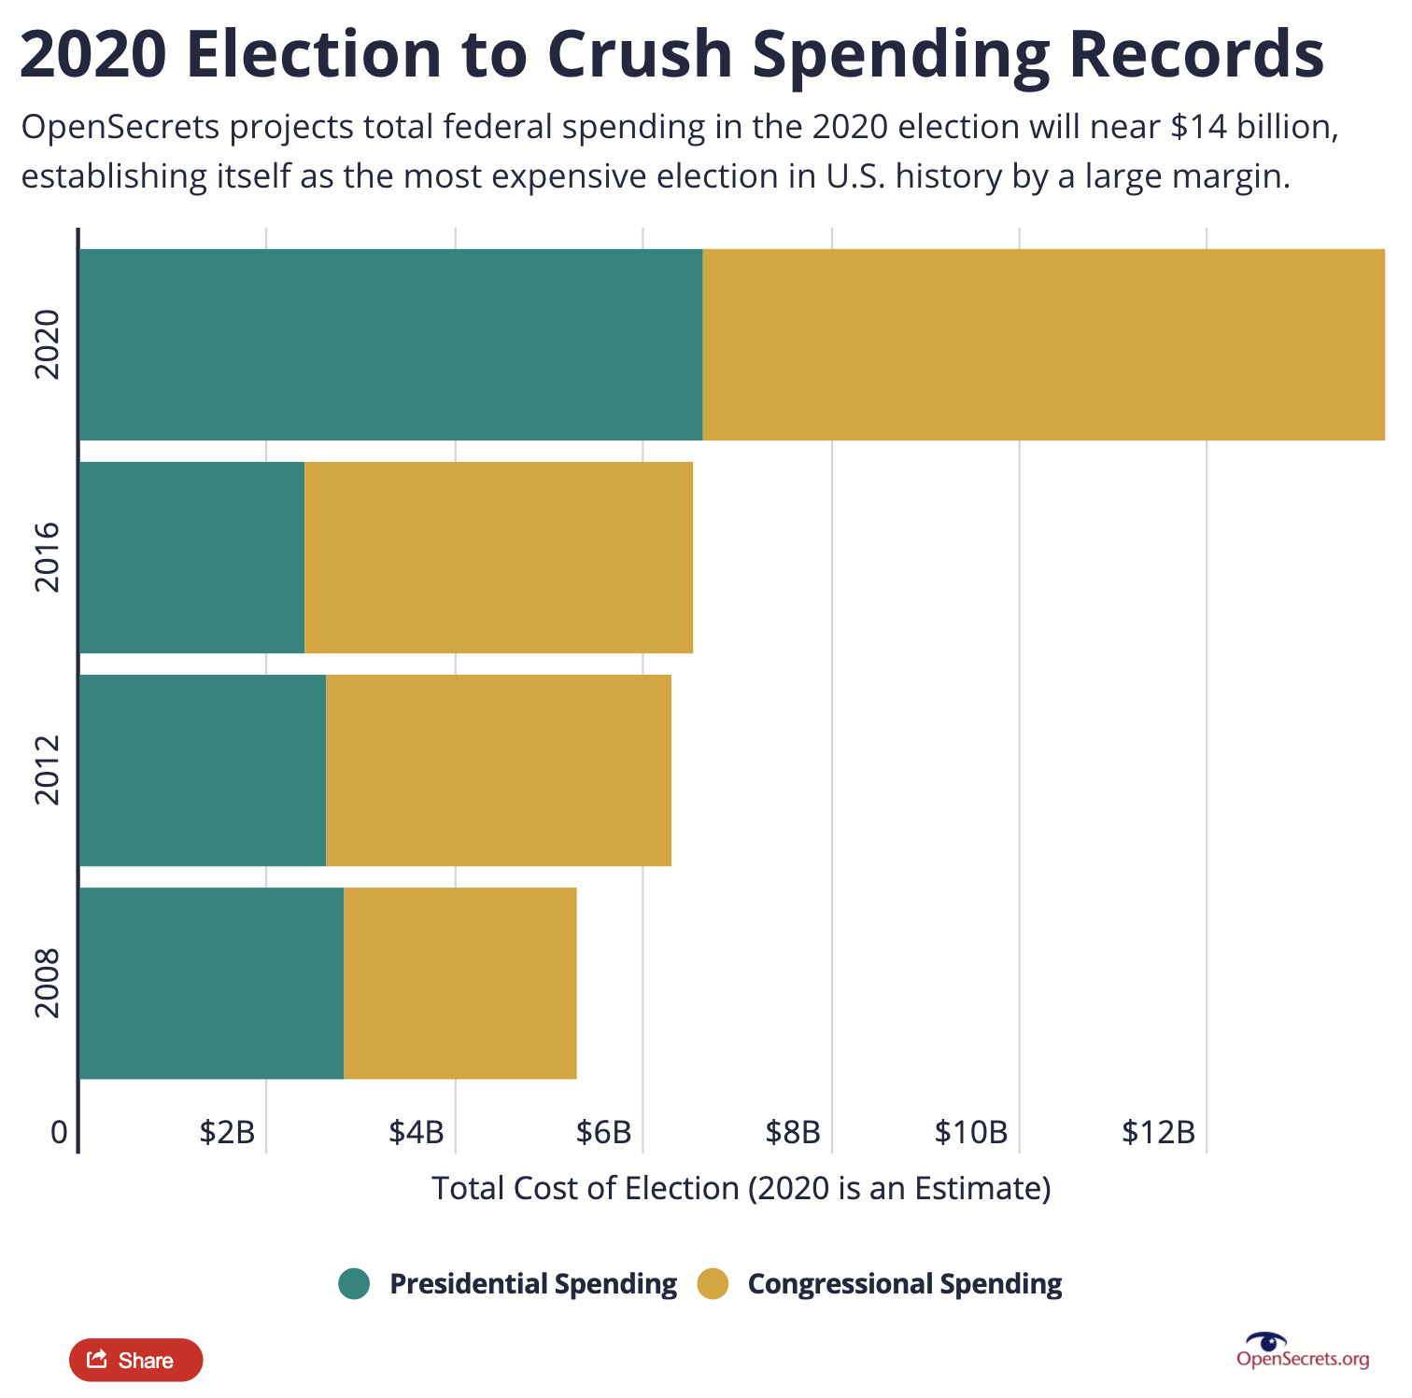
Money in politics continues to surge

Slide 3
What motivates political donors?

Slide 4
Access-Oriented
Notes:
Monolith

Slide 5

Access-Oriented

Slide 6
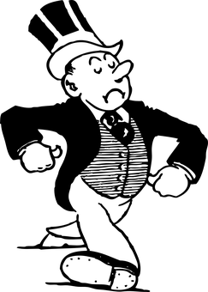
Access-Oriented
Andrew the Access-Oriented Donor
Notes:
Monolith

Slide 7
Consumption-Oriented
Notes:
Monolith

Slide 8

Consumption-Oriented
Notes:
Monolith

Slide 9
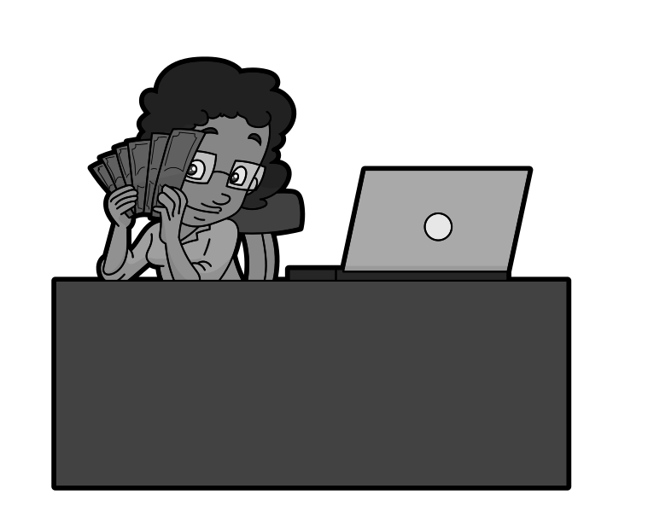
Connie the Consumption-Oriented Donor
Consumption-Oriented
Notes:
Monolith

Slide 10
Political Donor Motivation Models
Access-Oriented
Consumption-Oriented
Notes:
Monolith

Slide 11
Political Donor Motivation Models
Access-Oriented
Consumption-Oriented
Notes:
Monolith

Slide 12
Political Donor Motivation Models
Access-Oriented
Consumption-Oriented
Notes:
Monolith

Slide 13
Political Donor Motivation Models
Access-Oriented
Consumption-Oriented
Or
Notes:
Monolith

Slide 14
Political Donor Motivation Models
Access-Oriented
Consumption-Oriented
Or And
Notes:
Monolith

Slide 15

Analysis

Slide 16
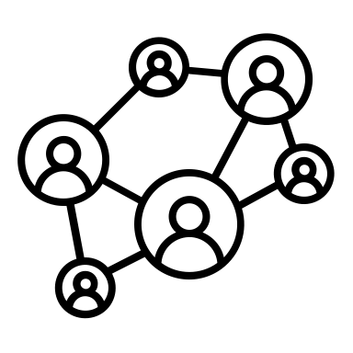
Analysis

Slide 17


Analysis

Slide 18
Analysis
+

Slide 19
Analysis
+

Slide 20
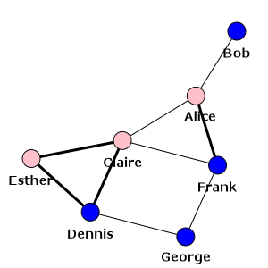
Political Donations as Network
Network terms:
Nodes
Edges
Source: igraph.org

Slide 21
Political Donations as Network
Nodes
Donors and Candidates
Edges
Donations between Donors and Candidates

Slide 22
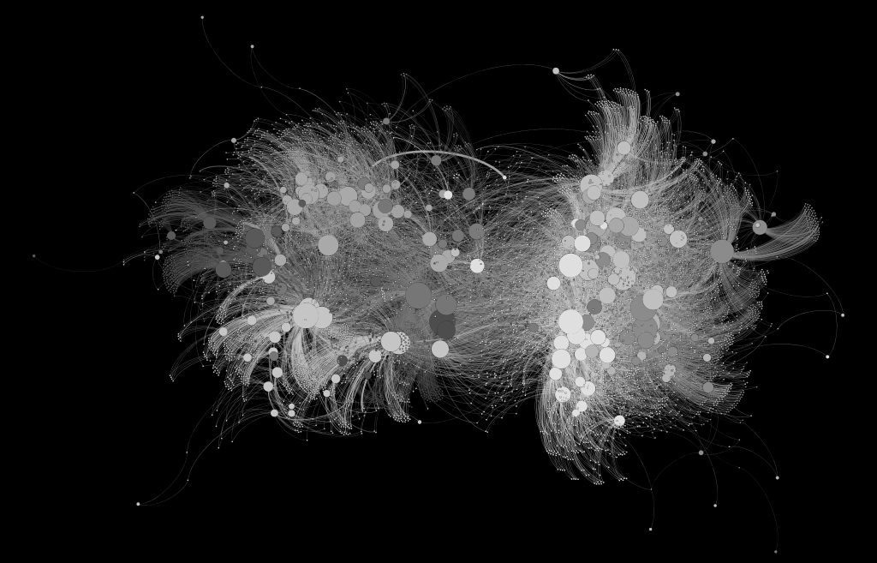
Political Donations as Network
Nodes
Donors (n = 7,567)
and Candidates (n = 149)
Edges
Donations (n = 28,858)
between Donors and Candidates

Slide 23
Political Donations as Network
Nodes
Donors (n = 7,567)
and Candidates
Edges
Donations (n = 28,858)
between Donors and Candidates
Democrats
Republicans

Slide 24
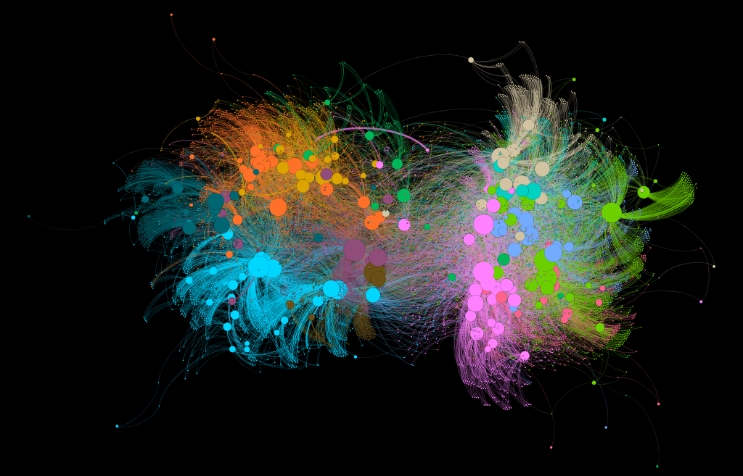
Political Donations as Network
Cluster Donors
Democrats
Republicans

Slide 25
Political Donations as Network
0 1 2 3 4 5 6 7 8 9 10 11 12
Complex system
To 2-D
To 1-D
Democrats
Republicans

Slide 26
Political Donations as Network
0 1 2 3 4 5 6 7 8 9 10 11 12
Complex system
To 2-D
To 1-D

Slide 27
Political Donations as Network
0 1 2 3 4 5 6 7 8 9 10 11 12
Which groups are Andrews?
Which groups are Connies?

Slide 28
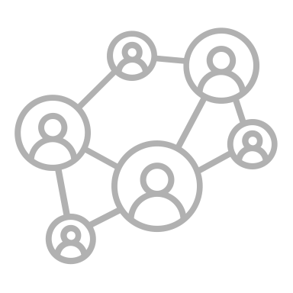

Analysis
+

Slide 29
Social Media
Facebook and Twitter posts

Slide 30
Social Media
Facebook and Twitter posts
All posts by 149 candidates for Wisconsin state legislature in the 2016 election cycle

Slide 31
Social Media
Facebook and Twitter posts
All posts by 149 candidates for Wisconsin state legislature in the 2016 election cycle
1/1/2015-11/8/2016

Slide 32
Social Media
Facebook and Twitter posts
All posts by 149 candidates for Wisconsin state legislature in the 2016 election cycle
1/1/2015-11/8/2016
n = 82,851

Slide 33
Social Media
Hand-coded ~12,000

Slide 34
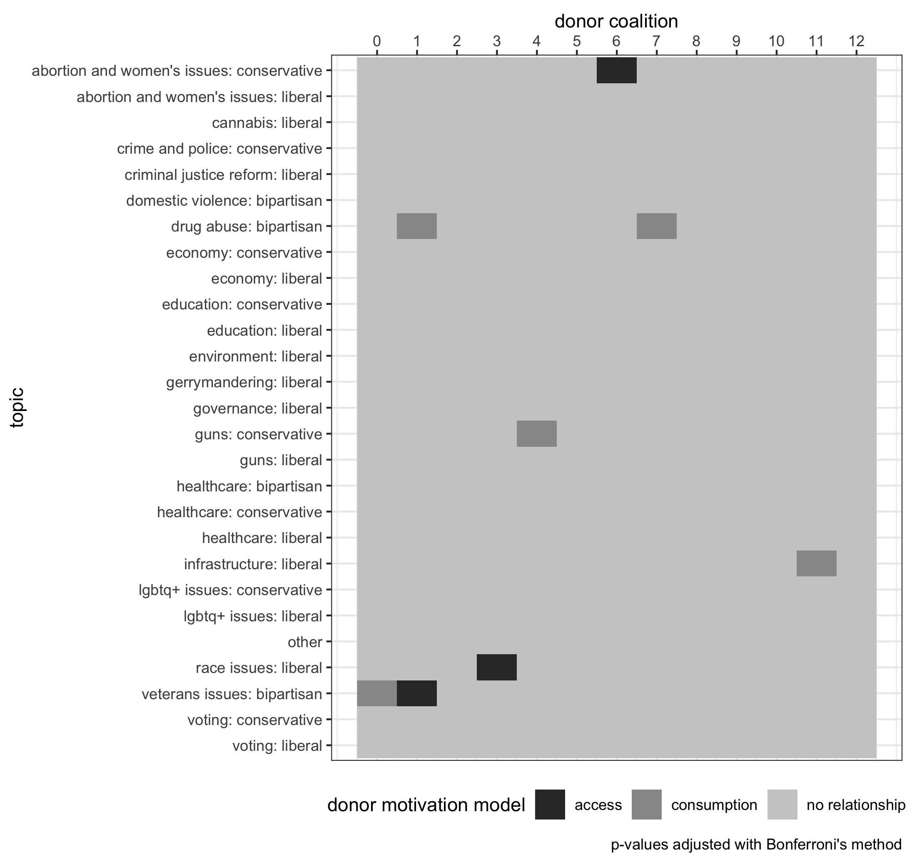
Social Media
Hand-coded ~12,000
Into 27 categories

Slide 35
Social Media
Hand-coded ~12,000
Into 27 categories
Trained Deep Learning Model to classify the rest of the posts
82.9% accuracy

Slide 36
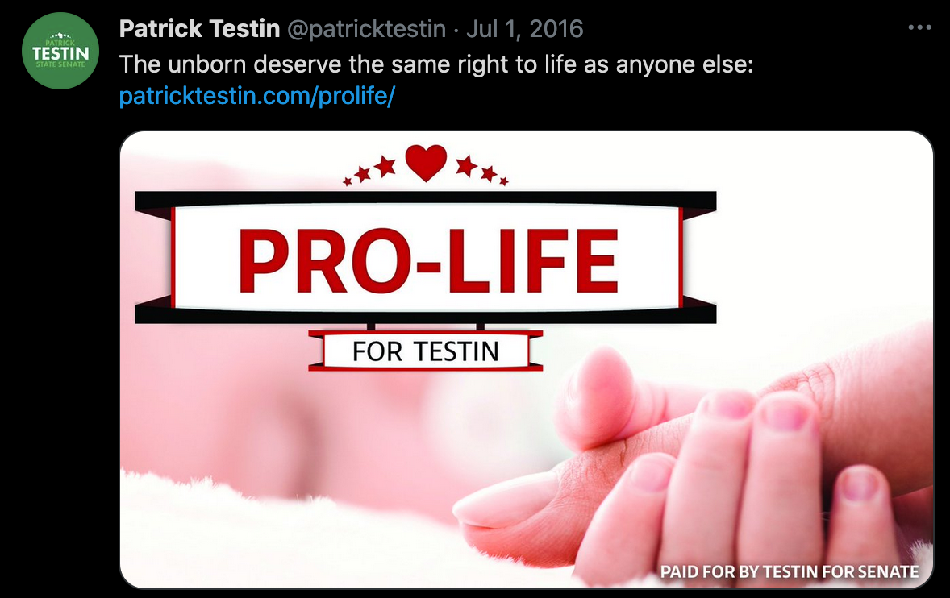
Social Media
Hand-coded ~12,000
Into 27 categories
Trained Deep Learning Model to classify the rest of the posts
82.9% accuracy

Slide 37
Social Media
Hand-coded ~12,000
Into 27 categories
Trained Deep Learning Model to classify the rest of the posts
82.9% accuracy

Slide 38
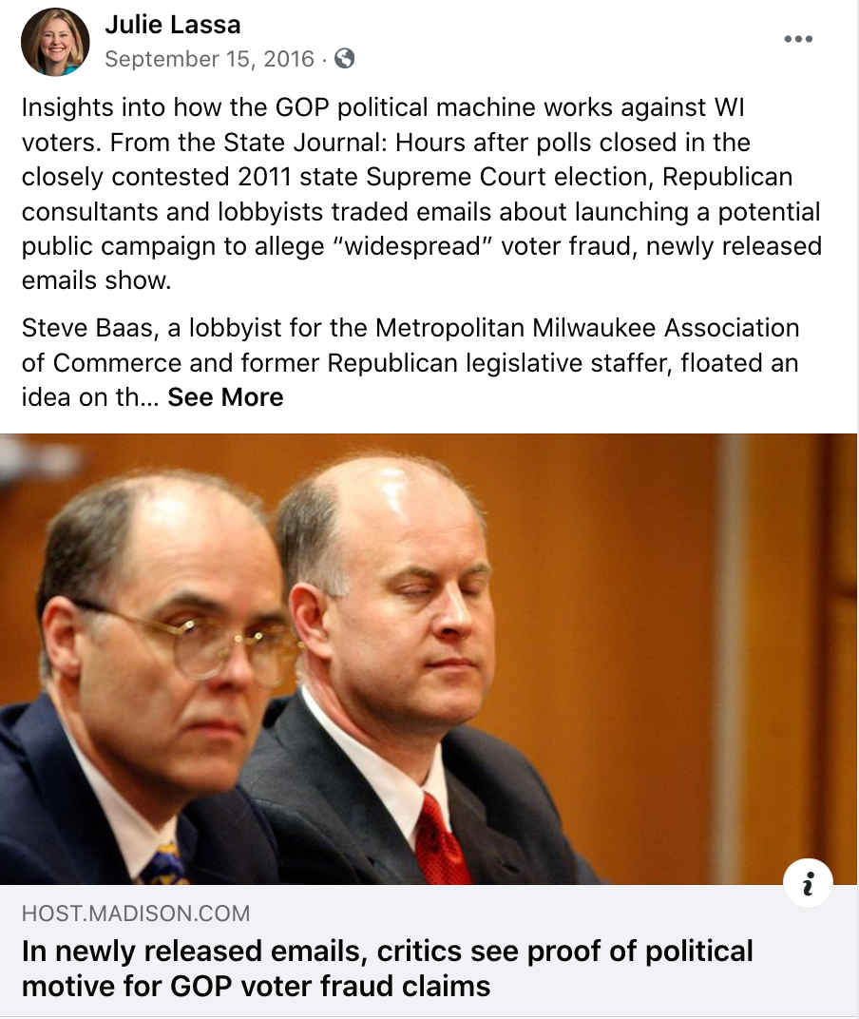
Social Media
Hand-coded ~12,000
Into 27 categories
Trained Deep Learning Model to classify the rest of the posts
82.9% accuracy

Slide 39
Social Media
Hand-coded ~12,000
Into 27 categories
Trained Deep Learning Model to classify the rest of the posts
82.9% accuracy

Slide 40
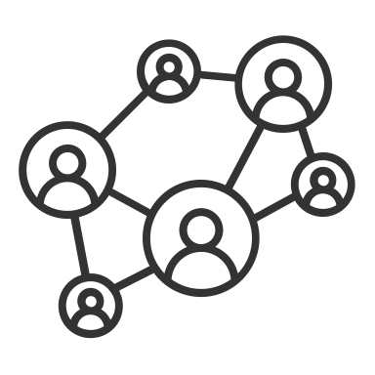

Analysis
+

Slide 41
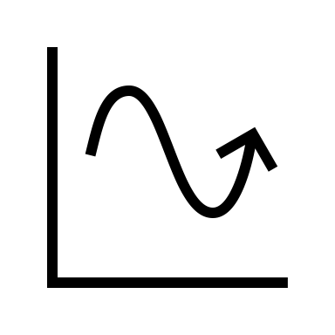
Analysis

Slide 42
Time-Series Model
Granger Causality
Does one time-series helpfully predict another?
What would we expect to see?

Slide 43
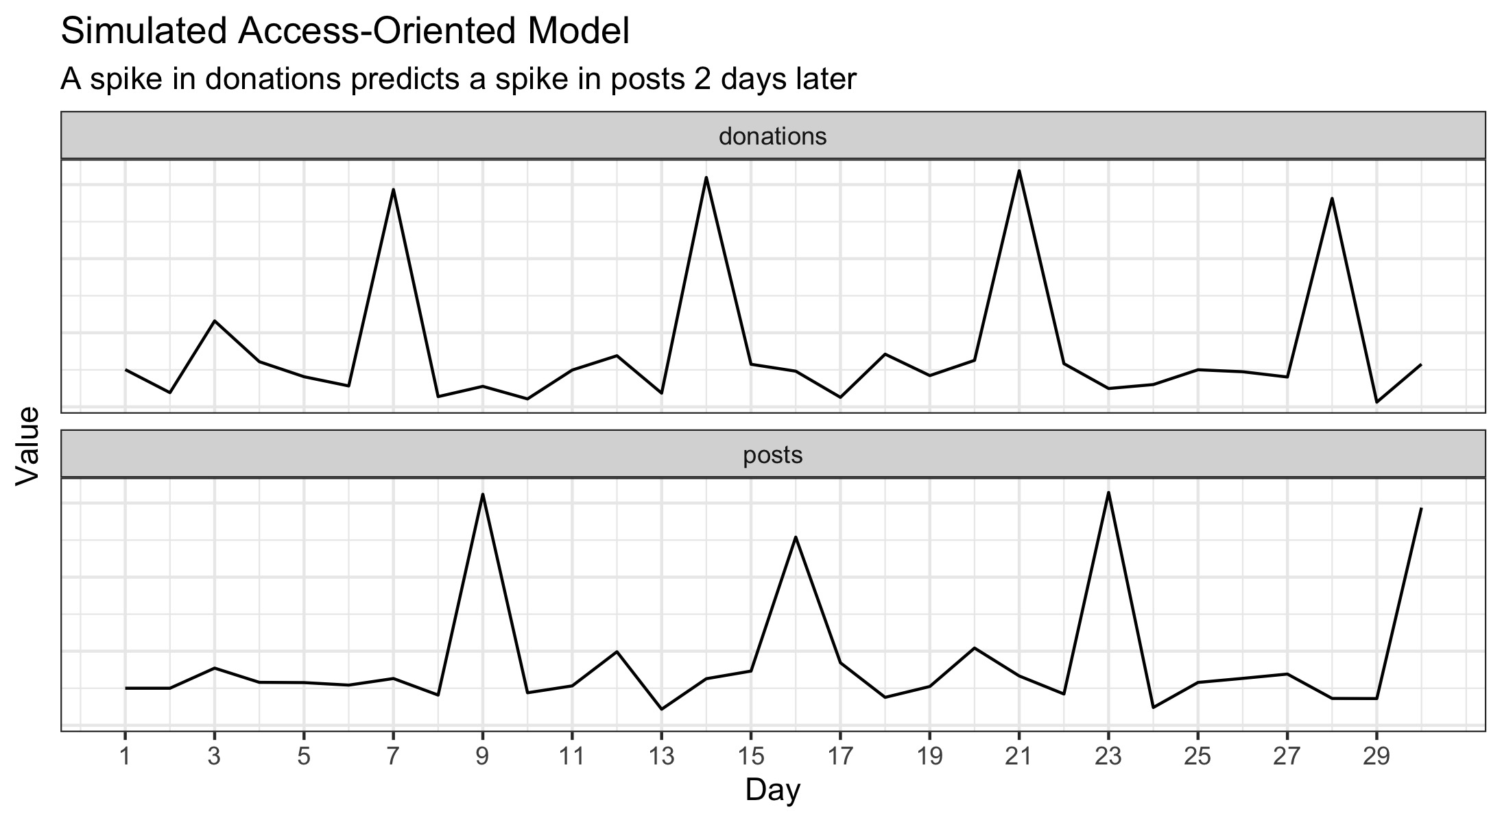
Simulated Model
Access-Oriented
Notes:
Monolith

Slide 44
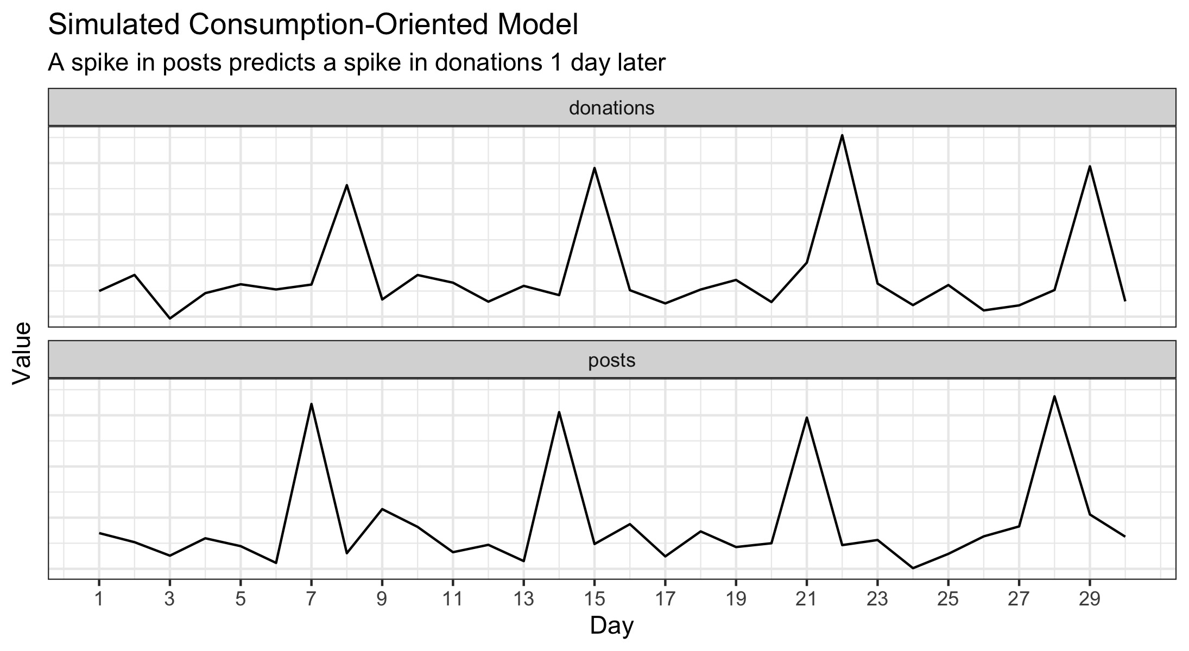
Simulated Model
Consumption-Oriented
Notes:
Monolith

Slide 45
Results

Slide 46
Results

Slide 47
Results

Slide 48
Results
3 clusters of access-oriented
5 clusters of consumption-oriented

Slide 49
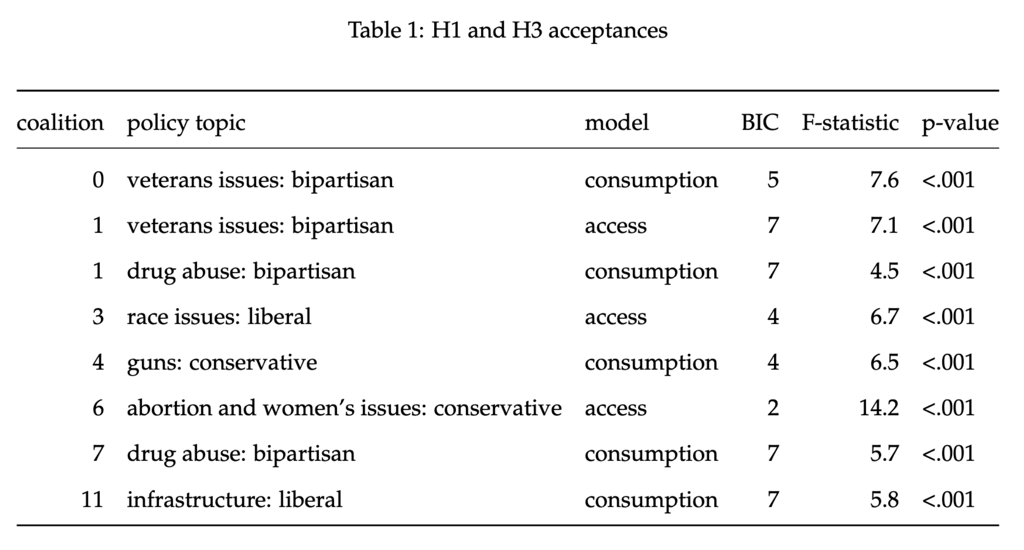
Results
3 clusters of access-oriented
5 clusters of consumption-oriented

Slide 50

Access-Oriented
Donor cluster #1
Donations predict campaigns to post about veterans' issues
Democrats
Republicans
Notes:
Monolith

Slide 51

Consumption-Oriented
Donor cluster #4
Candidates’ pro-gun posts predict donations
Democrats
Republicans
Notes:
Monolith

Slide 52
Result: Both donor models exist

Slide 53
Other Hypotheses
Access-Oriented
Consumption-Oriented
Notes:
Monolith

Slide 54
Other Hypotheses
Access-Oriented
Larger donors
Consumption-Oriented
Smaller donors
Notes:
Monolith

Slide 55
Other Hypotheses
Access-Oriented
Larger donors
More moderate
Consumption-Oriented
Smaller donors
More polarized
Notes:
Monolith

Slide 56
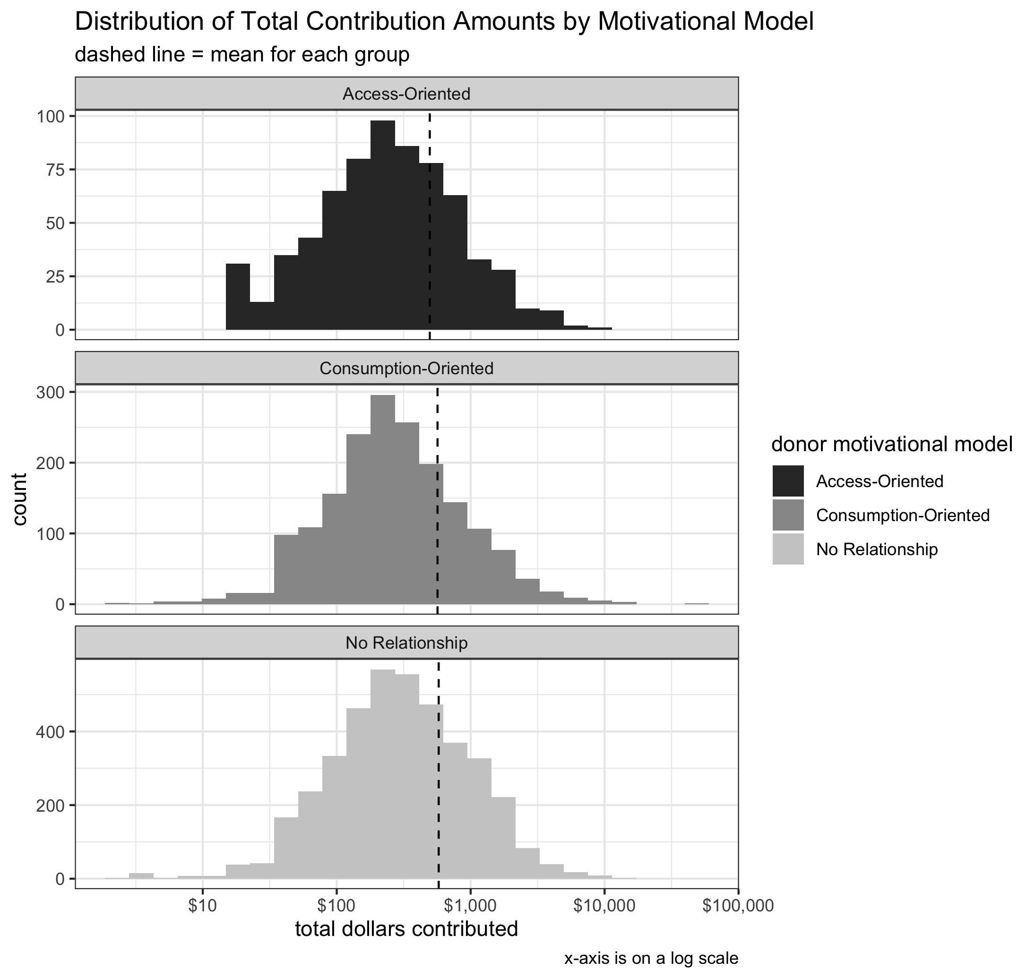
Donor Sizes

Slide 57
Donor Sizes
Are access-oriented donors bigger?
Are consumption-oriented donors smaller?

Slide 58
Donor Sizes
Are access-oriented donors bigger?
Are consumption-oriented donors smaller?
No

Slide 59
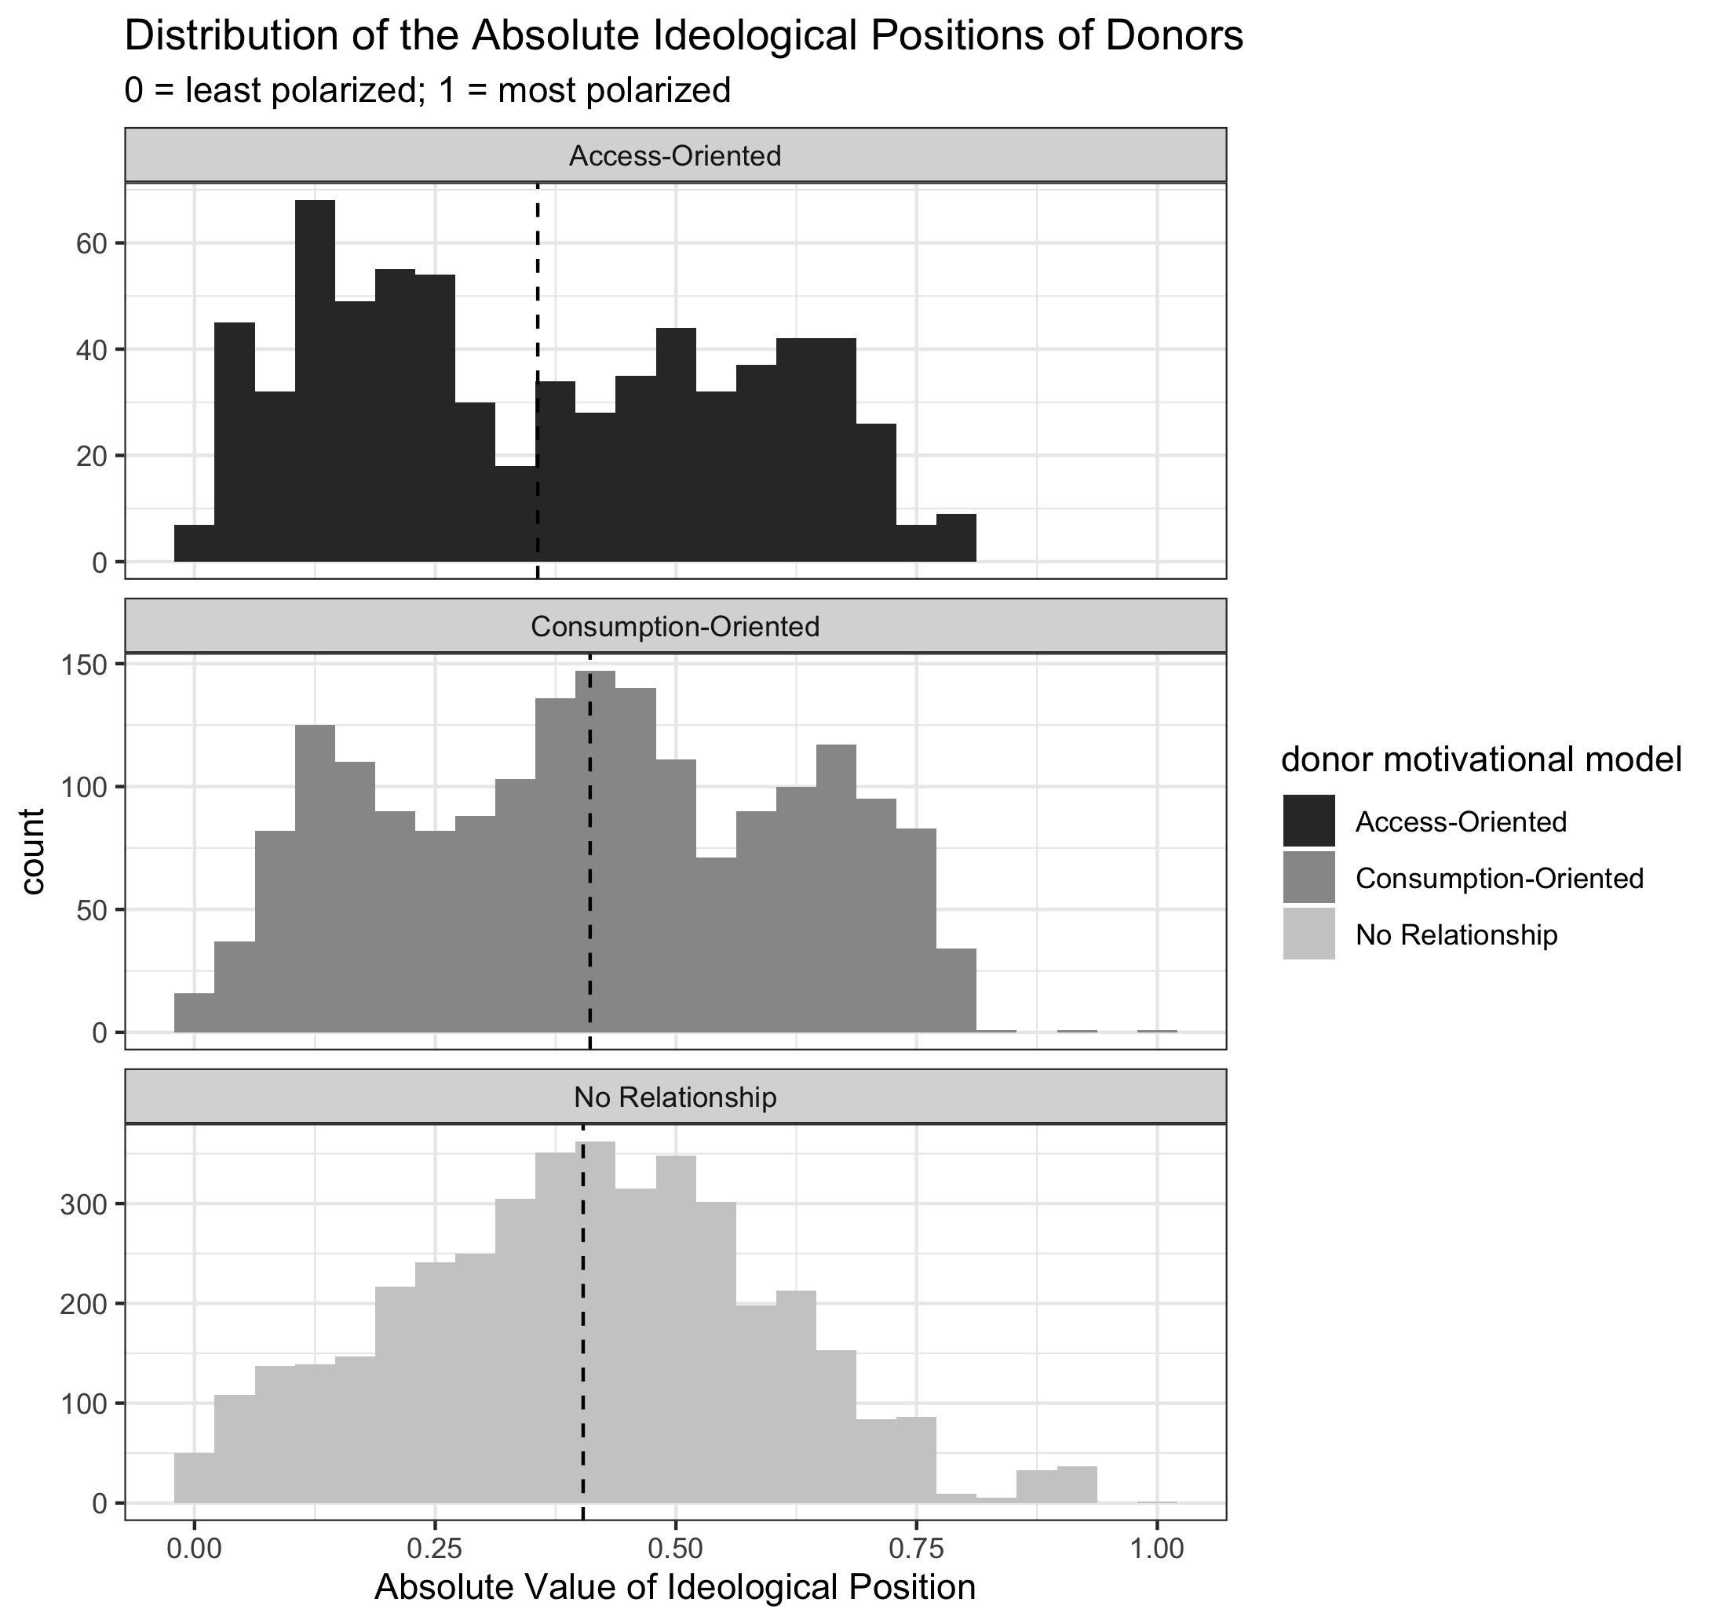
Donor Polarization

Slide 60
Donor Polarization
Are consumption-oriented donors in more polarized positions?
Are access-oriented donors in more moderate positions?

Slide 61
Donor Polarization
Are consumption-oriented donors in more polarized positions?
Are access-oriented donors in more moderate positions?
Yes

Slide 62
Other Hypotheses
Access-Oriented
Larger donors
More moderate
Consumption-Oriented
Smaller donors
More polarized
Notes:
Monolith

Slide 63


Other Hypotheses
Access-Oriented
Larger donors
More moderate
Consumption-Oriented
Smaller donors
More polarized
Notes:
Monolith

Slide 64
If we extrapolate…
2.5M itemized donors in 2020 (Open Secrets)

Slide 65
If we extrapolate…
2.5M itemized donors in 2020
500,000 access-oriented donors
Attempting to gain access to politicians

Slide 66
If we extrapolate…
2.5M itemized donors in 2020
500,000 access-oriented donors
Attempting to gain access to politicians
900,000 consumption-oriented donors
Potentially polarizing our politics

Slide 67
Which group should we care more about?
Notes:
Understanding political donors reveals the dynamics between influence and participation

Slide 68


Thank you
Ross Dahlke
@ross_dahlke
github.com/rossdahlke
Stanford University
rdahlke@stanford.edu
Democrats
Republicans

Slide 69
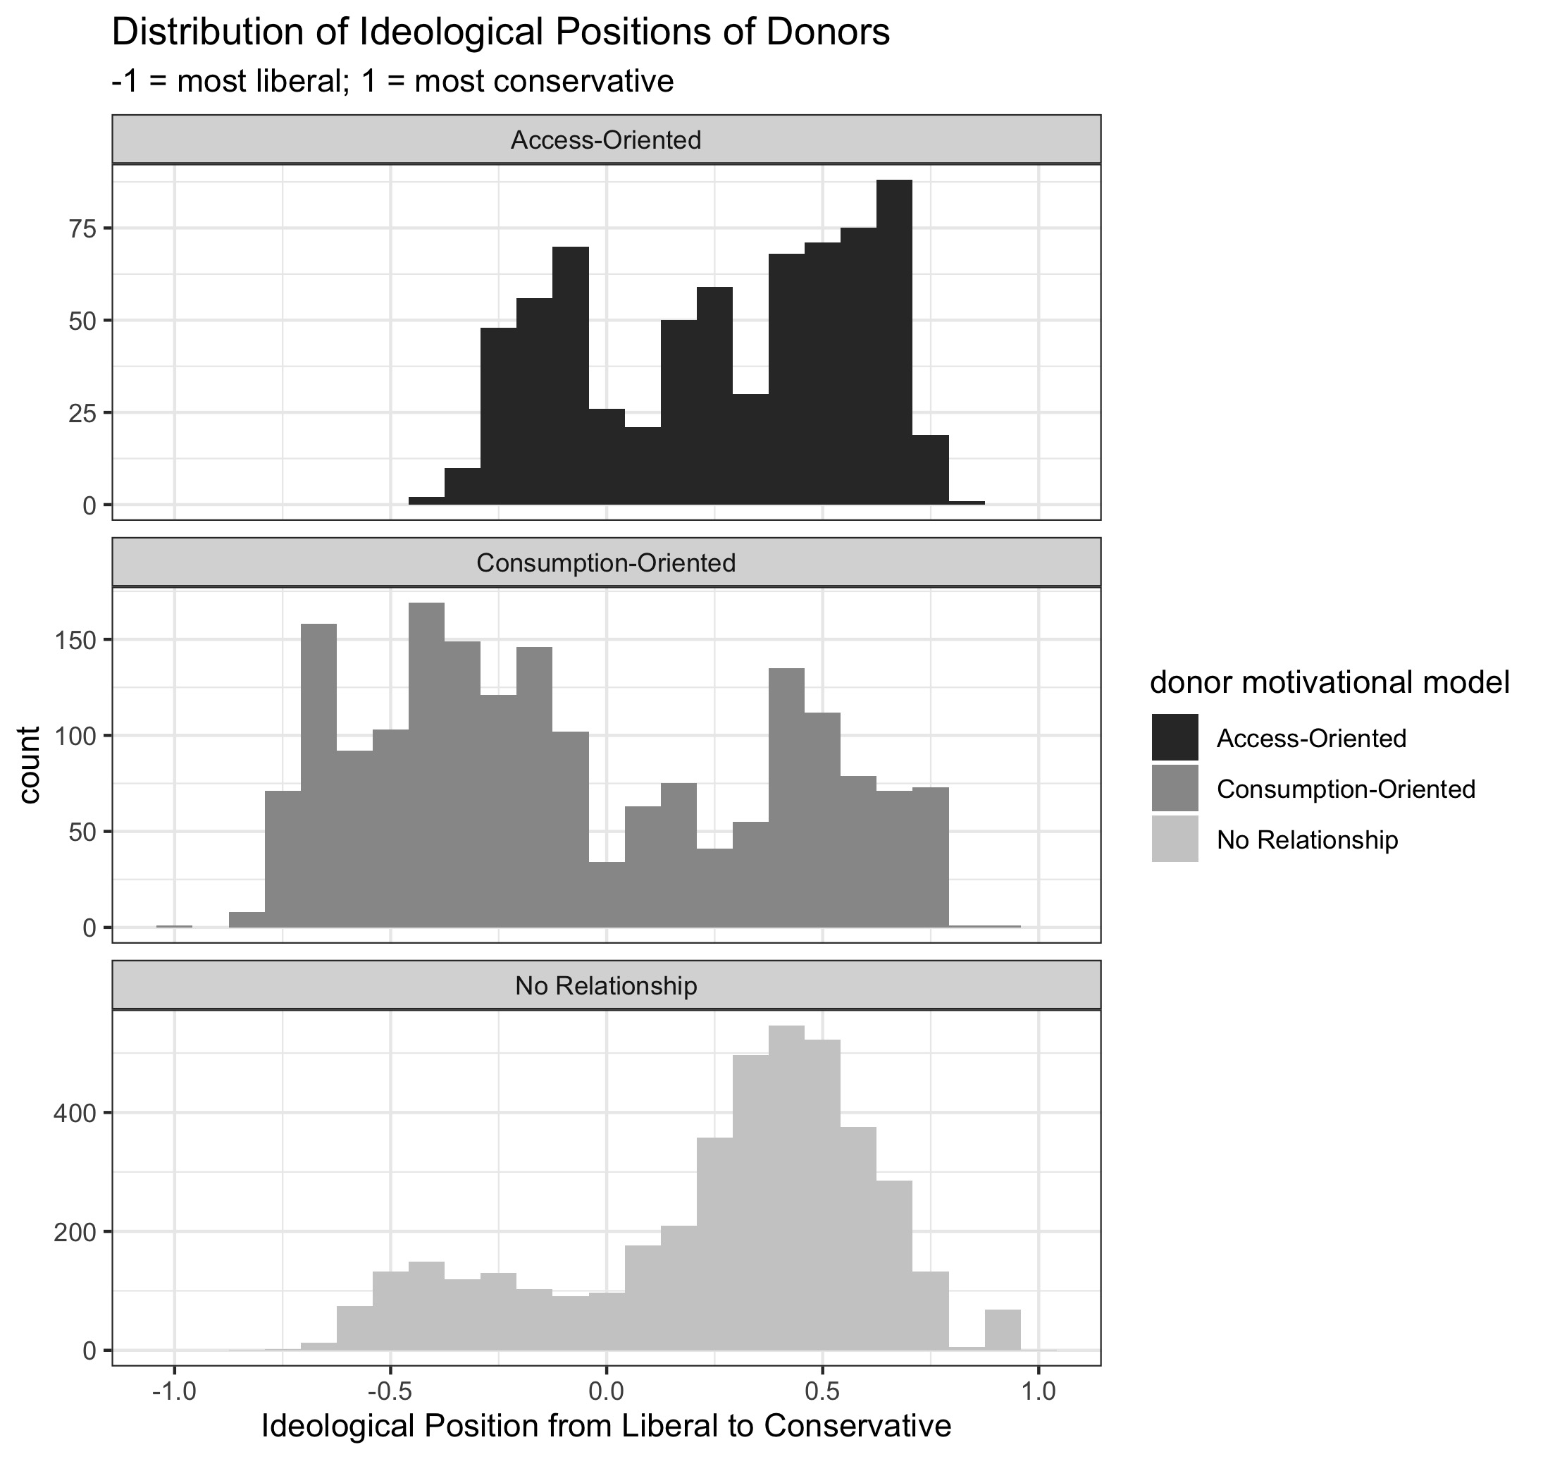
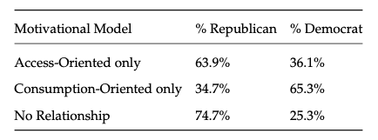
Donor Types

Slide 70
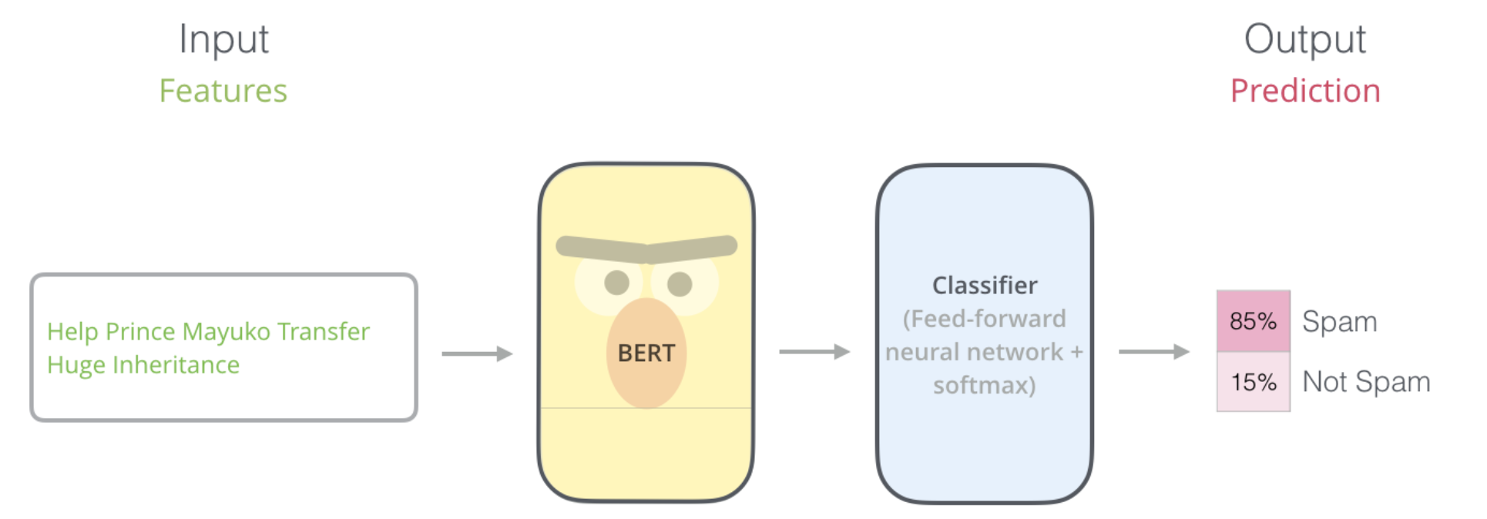
BERT: Pre-training of Deep Bidirectional Transformers for Language Understanding
Source: jalammar.github.io/illustrated-bert/

